Slide 1
IBM HR Analytics By Yash Pasar & Trisha Chakraborty

Slide 2

Poster Story
The employee attrition of staff can be due to voluntary or involuntary reasons. Employee attrition can have a negative impact on the remaining employees if it leads to an increase in their workload. It also can limit promotional opportunities and movement within the company, resulting in an unhappier workplace or more attrition than was intended. This study is to use data to tell the story of the employee attrition of IBM to the HR department and create a more comprehensive picture of the problems employee face.
This study aims to answer three research questions:
What are the major factors causing employee turnover?
Which gender and age prefers leaving the company often?
How are overtime and delays in promotion affecting attrition?

Slide 3
Checkpoints
Data Description:
This data is retrieved from Kaggle and has 1470 rows and 35 columns. Fields used for analysis are “Monthly Income”, “Hourly Rate”, “Daily Rate”, “Gender”, “Age”, “Business Travel”, “Years at company”, “Attrition” and Years since last promotion.
Audience:
This Analysis would help IBM HR Department in creating an effective human resource management plan.
Source:
Kaggle

Slide 4
More Business Questions
How many people feel that environment satisfaction and work life balance is a necessity?
Based on the department, how many people leave the company?

Slide 5

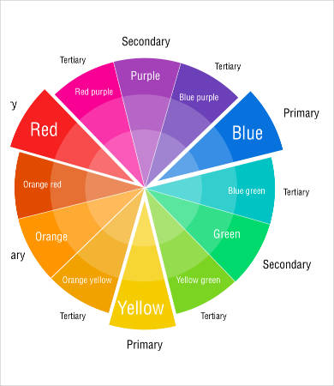
Color Wheel

Slide 6
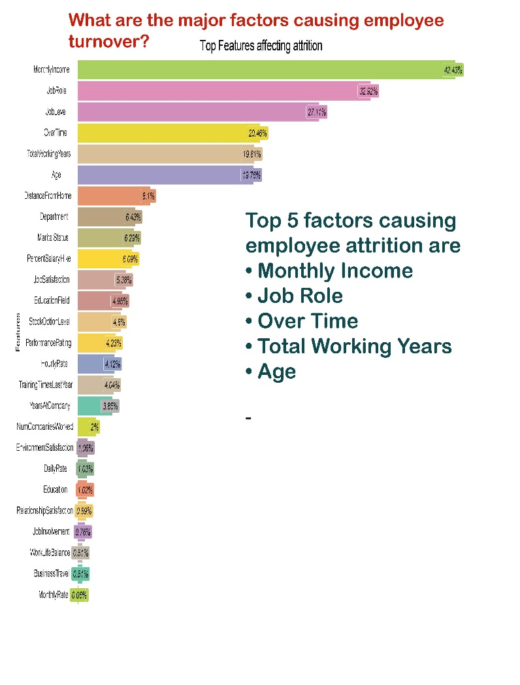
Key Visualization
Major factors affecting employee Turnover

Slide 7

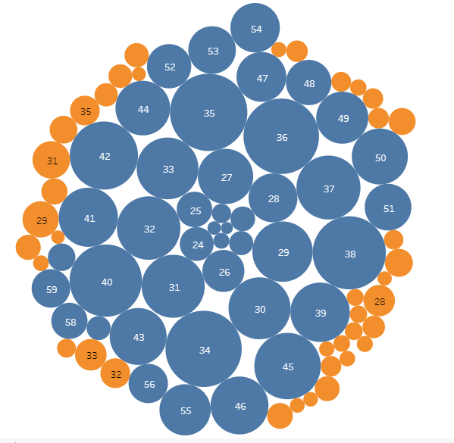
Key Visualization
Attrition based on the Age

Slide 8
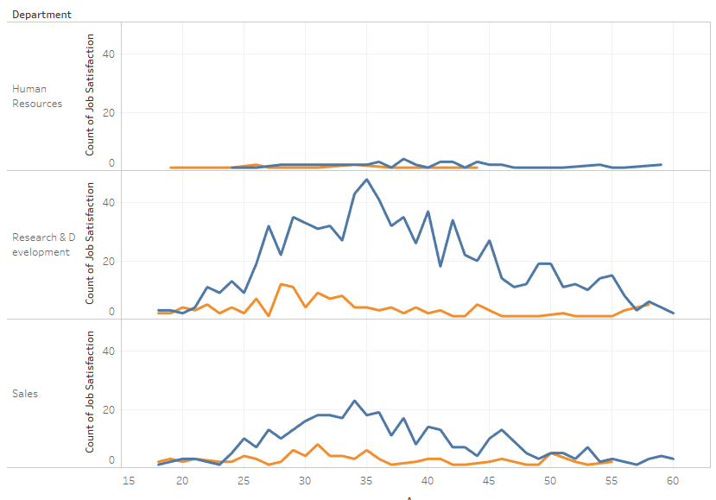
Key Visualization

Slide 9
Data Encoding: We will incorporate visual encoding techniques discussed in the class to show the outliers, increase, decrease and change patterns in data.
Color: Red, Green, White.
Layout and use of space: The main plot will describe the factors affecting attrition in IBM with supporting one dimensional and multi dimensional plots. The main plot will be placed in center surrounding the supporting plots for answering our business questions.
WOW Factor: We intend to perform machine learning to generate key insights and create colorful and meaningful visualizations based on it.

Slide 10
Thank You

